Slide 1

Annual Members vs Casual Riders
How they Differ.
Tom Casadonte
11/11/22

Slide 2

Objective
How do casual riders differ from membership riders.
Why casual riders would buy a membership.

Slide 3
Objective
How do casual riders differ from membership riders.
Why casual riders would buy a membership.

Slide 4
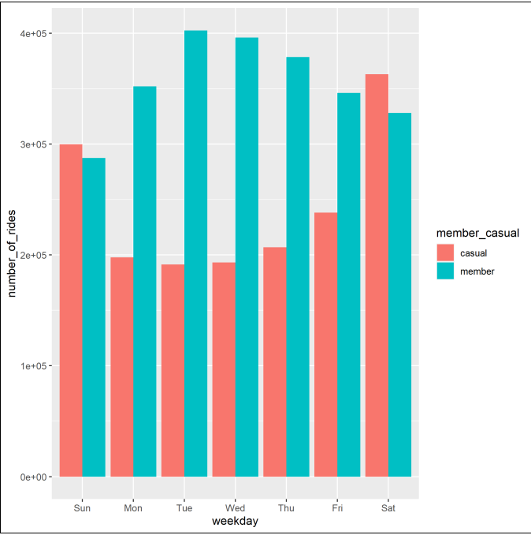
Number of Riders per day
Casual riders exceed members on weekend days.
Casual riders have a steady level of usage during the week.

Slide 5
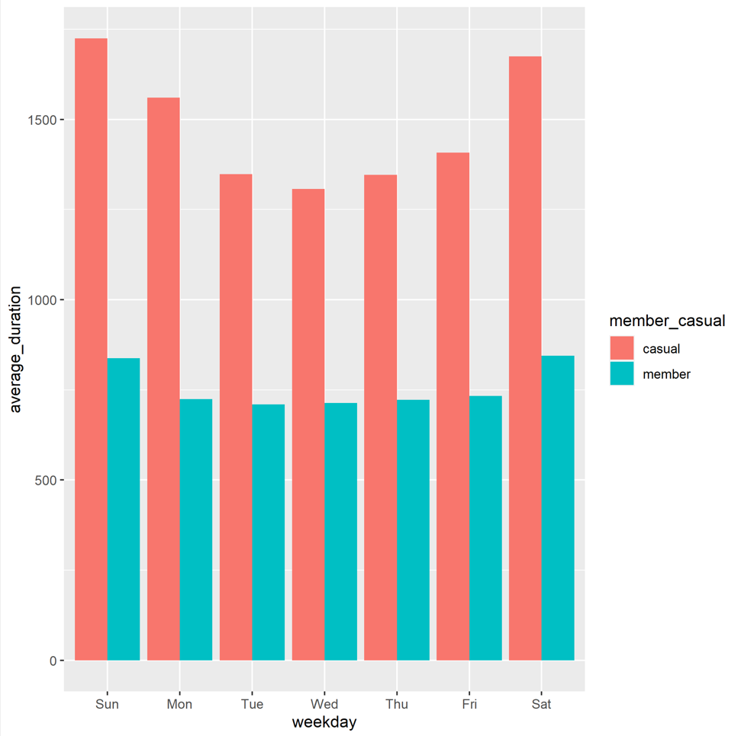
Average usage time
Casual riders tend to have a longer usage time.
Members are very regular in their usage.

Slide 6
Objective
How do casual riders differ from membership riders.
Why casual riders would buy a membership.

Slide 7
Casual Rider Trends
Steady usage during the week suggest there is a regular user group that could benefit from a membership.
Average duration during the week along with steady usage suggests a regular route is taken on a daily basis

Slide 8
Conclusion
There is a sizable regular “casual” rider population that could benefit from a cyclistic membership.

Slide 9
Next steps
Confirm individual customers do repeat their rides on a regular basis.
Review ride time and location
Review ride cost for regular casual riders.
Engage identified regular casual riders with targeted marketing campaign to inform them how a membership could benefit them.

